Slide 1
DM therapy
Goals for Therapy OUTpatients
Fasting Plasma Glucose: < 130 (normal 70 – 100)
Post-prandial < 180
HgA1c < 7.2% (normal 5.7 - 6.4%)
Goals for Therapy INpatients
Goal: 140 - 180
Diabetic Care
HgA1c q3-6 months
Dilated eye exam qyear

Slide 2
7 things to manage: Nutrition, BP, LDL, Immunizations, Aspirin, Neuropathy, Smoking
Nutrition:
50-60% of daily calories
< 7% from saturated fat
30 min exercise 3-4 times a week
5. Management of Platelets
If
Framingham > 10%
Men > 50 y/o
Women > 60 y/o
Then
Aspirin 81 mg PO daily
2. Management of BP
Goal < 130/80
Add ACE-I or ARB
Else
Diltiazem
3. Management of Dyslipidemia
Goal LDL < 100
If LDL > 100
Statin + lifestyle
Or
Age > 40 y/o
Statin + lifestyle
(to reduce inflammation)
6. Management of Neuropathy
If no:
Constipation
then
TCA
Amitriptyline
Or
Imipramine
Anti-Epileptic
Pregabalin (Lyrica)
Or
Gabapentin
Or
Carbamazepine
4. Management of Immunizations
If > 6 months of age: Annual influenze
If adult: 1 lifetime pneumoccal vaccine
Hepatitis A, hepatitis B, PPSV23, Tdap
7. No smoking

Slide 3
Total daily insulin dose (TDI) = Weight (lb) / 4
50% basal
50% regular
Insulin effect on carbs
1 unit = 10 carbs
1 unit = 500/TDI (gram of carbs)
Insulin effect in BG
1 unit = 50 mg/dL
1 unit = 1800/TDI gram of carbs

Slide 4
Treatment of DM-1
Total Daily Dose
Initial Dose: 0.5 – 0.6 Units/kg
Honeymoon Phase 0.1 – 0.4 Units/kg
Illness 0.5 – 1 Units/kg
If low in insulin: increase/decrease by 3 units
1-2 units of insulin will decrease BG ~ 50mg/dl
50%: Long Acting
50%: Short Acting
Total kg
Total Units of
Insulin
=
4
Notes:
http://dtc.ucsf.edu/types-of-diabetes/type2/treatment-of-type-2-diabetes/medications-and-therapies/type-2-insulin-rx/calculating-insulin-dose/

Slide 5
Insulin
Generic 100 Units/ml, 10 ml vial | Brand | Onset: Peak: | Admistration Appearance
Aspart | NovoLog | Onset: 15 min Peak: 1 hr Duration: 2 hr | SQ, IV Clear
Lispro | Humalog | Onset: 15 min Peak: 1 hr Duration: 2 hr | SQ, IV Clear
Glulisine | Apidra | Onset: 15 min Peak: 1 hr Duration: 2 hr | SQ, IV Clear
Regular Comes in 500 U/ml, 20 ml vial | Humulin R Novolin R | Onset: 30 min Peak: 2 hr Duration: 4 hr | SQ, IV Clear
NPH | Humulin N Novolin N | Onset: 1 hr Duration: 12 hours | SQ Cloudy
Glargine | Lantus | Onset: 1 hr Duration: 24 hr | SQ Clear
Detemir | Levemir | Onset: 1 hr Duration: 24 hr | SQ Clear
Excretion via kidneys

Slide 6
HgA1c
> 9 Insulin
7.6 – 9 2 PO drugs
6.5 – 7.5 1 PO
< 6.5% no Rx
DM2
Pregnant
Or A1C > 9%
If CrCl > 50 or
If SrCr < 1.5
If CrCl < 50 or
SrCr > 1.5
Lifestyle +
Metformin
Sulfonylurea
(Glipizide)
No sulfa allergy
No HF (actos)
HF = true
No sulfa allergy
No renal
No HF (actos)
Lifestyle
+
Metformin
500 mg BID
+
Sulfonylurea
Lifestyle
+
Metformin
500 mg BID
+
Basal Insulin
10 U daily
Lifestyle
+
A Sulfonylurea
(glypizide)
+
Pioglitazone (Actos)
15 mg daily
Lifestyle
+
DPP-IV
Sitagliptin
+
Pioglitazone
Lifestyle
+
Basal Insulin
Basal Insulin
Lifestyle
+
Metformin
+
Intensive insulin
(pre-prandial)
Lifestyle
+
Basal insulin
Lifestyle
+
Basal insulin
Notes:
Reduce liver glucose production: Metformin,
Secretion of insulin: sulfonylurea
Peripheral sensitizer: TZD (Pioglitazone)
DPP-4 inhibitor (Sitagliptin, Januvia)
Alpha glucosidase (Arcabose, Precose): reduce postprandial hyperglycemia

Slide 7
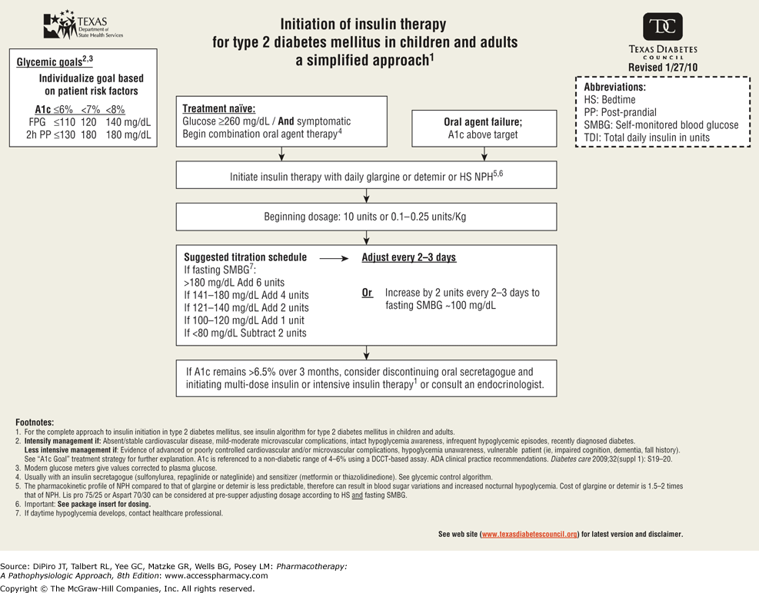
Insulin treatment

Slide 8
KNOW: Titrating insulin in type 2 DM
1. Start 10 units Glargine qHS
2. Self-monitor FPG values Increase of insulin dosage (units per day)
> 180 mg/dl 8
140-180 6
120-140 4
100-120 2
< 100 good

Slide 9
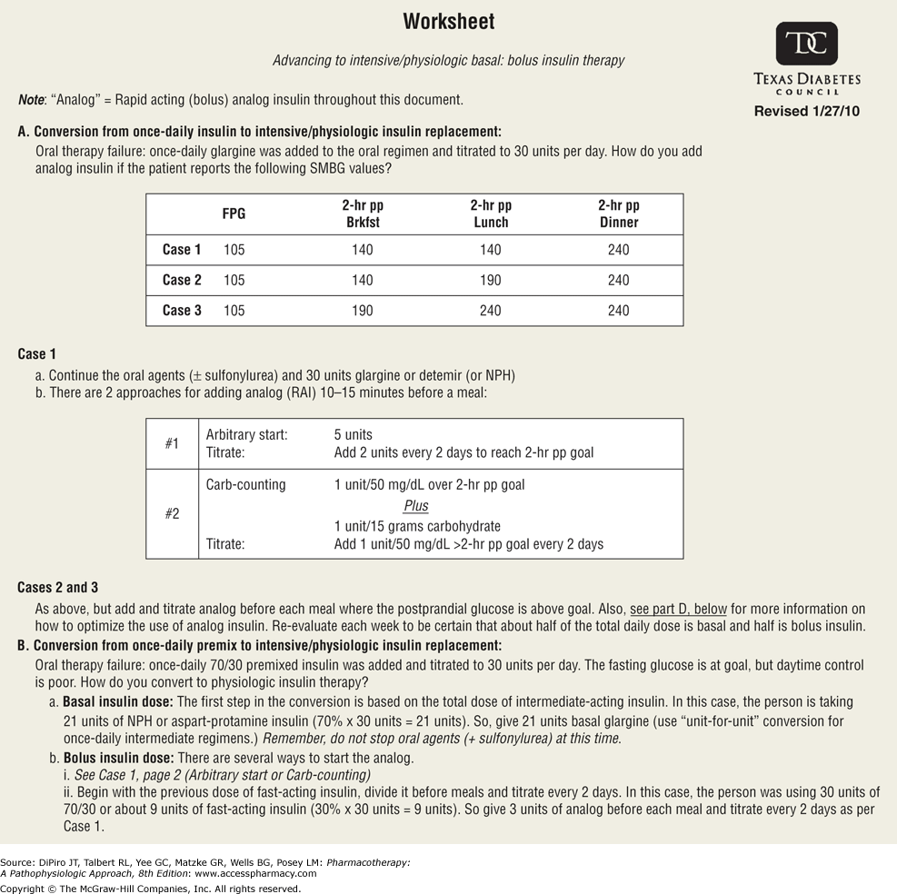
Example Case

Slide 10
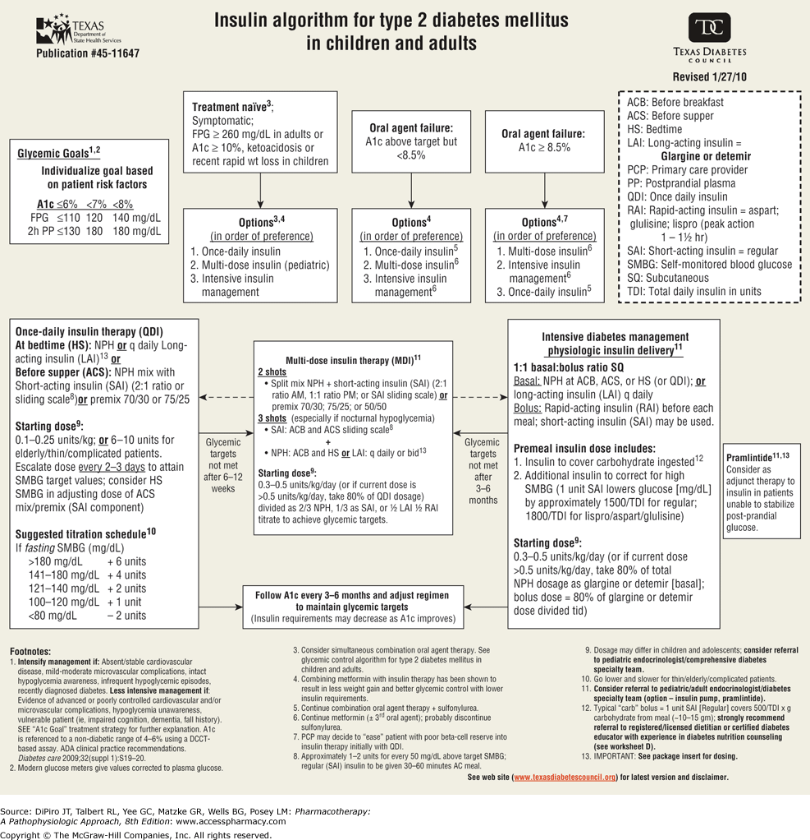

Slide 11
Drugs: overview
Liver/Periphery
Metformin
Thiazolidinediones(TZD)
Pancreas
Sulfonylurea
Meglitinide
GI tract
Alpha glucosidase inhibitor
Analogue
Amylin Analogue
Incretin Analogue
DPP-4 inhibitor
Usual Monitoring
Glycemic control
HgA1c every 3 months
Baseline renal function annually
LFT annually

Slide 12
Liver/Periphery
Biguanide (Metformin)
Efficacy
FPG: 50-60 mg/dL
HgA1c: 1-2%
Pros: DOC
No hyPOglycemia b/c act on liver
UKPDS-34: only PO drug that decreases mortality
Contraindications
Age > 80 y/o
Renal dysfunction (SrCr > 1.5)
Contrast dye test b/c renal(wait 48hrs before starting metformin again
Active Liver disease (ALT/AST 2.5x above normal)
Active alcoholics
CHF stage III or IV
ADR
GI 30%. That’s why patient is given initial dose of 500 mg BID to see if there is GI distress
Lactic Acidosis (50% will die)
a. Symptoms: Muscle pain, rapid breathing
Monitoring parameters
Baseline renal function, LFT annually
Glycemic control
HgA1c every 3-6 months
Generic | Brand | Dose
Metformin | Glucophage | Initial 500 mg BID Maintenance: 1500 mg daily Max: 2550 mg daily
Meformin XR | Glucophage Xr

Slide 13
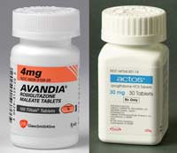
Periphery/Liver
TZD
MOA: Insulin sensitizer (PPAR receptor)
Efficacy
FPG: 40-50 mg/dL
HgA1c: 1.5%
Pros:
No Renal impairment (use if metformin is contra)
Lower insulin requirements
No hyperglycemia
Cons:
Takes up to 12 weeks for max response
Contraindications
HF III and IV: TZD can cause or exacerbate CHF
Active Liver disease
ADR
Hematologic: monitor CBC
Edema
Bladder Cancer
Monitoring parameters
Dexa scan (bone density)
LFT at baseline
HgA1c ever 3-6 months
Generic | Brand | Dose
Pioglitazone | Actos | Initial: 15 mg daily Maintenance: 30 mg daily Max: 45 mg daily
Rosiglitazone | Avandia | Last resort drug b/c CV (MI) Never with Insulin

Slide 14
Drugs: overview
Liver/Periphery
Metformin
Thiazolidinediones(TZD)
Pancreas
Sulfonylurea
Meglitinide
GI tract
Alpha glucosidase inhibitor
Analogue
Amylin Analogue
Incretin Analogue
DPP-4 inhibitor
Usual Monitoring
Glycemic control
HgA1c every 3 months
Baseline renal function annually
LFT annually

Slide 15
Pancreas
Sulfonylurea
MOA: Insulin Secrete
Administration: 30 min before meal
Efficacy
FPG: 50-60 mg/dL
HgA1c: 1-2%
Pros: 60 – 70% response rate
Cons: 10%/year will be useless b/c pancreas gets tired
ADR
Hypoglycemia
Weight gain
GI constipation
Photosensitive b/c of sulfa
Monitoring parameters
BS, renal function, HgA1c every 3-6 months
Signs and symptoms of adverse effects
Generic | Brand
Acetohexamide | Dymelor
Chlorpropamide (syndrome of inappropriate antidiuretic hormone hypersecretion → low Na) | Diabinese
TolaZamide | ToLINase
Tolbutamide | Orinase
Glimepiride | Amaryl
Glipizide Use if CrCl < 50 | Glucotrol 5 mg PO daily
Glyburide No good if CrCl < 50 | DiaBeta 2.5-5 mg/day
Notes:
Acetohexamide (ace + hex) -- Dymelor (die my lord)
Chlorpropamide (color propane) -- diabinaes (obese)
TolaZamide (zig zag) -- toLINase (line)
Tolbutamide (butt?) -- orinase (oral ass gross)
Glimepiride (pray) -- Amaryl (ameliana)
Glipizide (Zig Zag) -- glucotrol (control)
Glyburide (glyBuride) -- diaBeta

Slide 16
Pancreas
Meglitinide
(short t1/2 of sulfonylurea)
MOA: Secrete Insulin. bind to an ATP-dependent K+ (KATP) channel on the cell membrane of pancreatic beta cells in a similar manner to sulfonylureas but at a separate binding site.
Efficacy
Postprandial Glucose: 30 – 40 mg/dl
HgA1c: 0.7 – 1%
Pros:
Combo with Metformin
Short acting (short term sulfonylurea)
Cons:
HyPOglycemia b/c act on pancreas
Monitoring parameters
LFT
HgA1c q3-6 months
Generic | Brand | Dose
Repaglinide | Prandin | 15 min before meal
Nateglinide | Starlix | 15 min before meal

Slide 17
Drugs: overview
Liver/Periphery
Metformin
Thiazolidinediones(TZD)
Pancreas
Sulfonylurea
Meglitinide
GI tract
Alpha glucosidase inhibitor
Analogue
Amylin Analogue
Incretin Analogue
DPP-4 inhibitor
Usual Monitoring
Glycemic control
HgA1c every 3 months
Baseline renal function annually
LFT annually

Slide 18
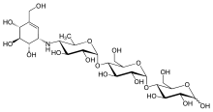
GI Tract
Alpha glucosidase inhibitor
MOA: delay breakdown of ingested complex carbs
reduces postprandial hyperglycemia
Efficacy
Postprandial Glucose: 50 – 60 mg/dl
HgA1c: 0.2 – 0.5%
Pros:
No hyperinsulinemia
No hyperglycemia
Cons:
Based on Weight
Contra in bowel ulcerations
Monitoring parameters
LFT every 3 months for the first year then qyear (metformin for example is LFT qyear)
Generic | Brand | Dosing
Acarbose | Precose | First bite of each meal Initial: 25 mg TID Maintenance: 50 mg TID if < 60kg 100 mg TID if > 60 kg Max: 100 mg TID
Miglitol | Glyset | First bite of each meal 25 mg TID Maintenance: 50 mg TID

Slide 19
Drugs: overview
Liver/Periphery
Metformin
Thiazolidinediones(TZD)
Pancreas
Sulfonylurea
Meglitinide
GI tract
Alpha glucosidase inhibitor
Analogue
Amylin Analogue
Incretin Analogue
DPP-4 inhibitor
Usual Monitoring
Glycemic control
HgA1c every 3 months
Baseline renal function annually
LFT annually

Slide 20
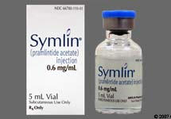
Analogues
Amylin Analogue
MOA: Amylin (cousin of insulin 1:100::amylin:insulin stimulates brain to
1. suppress glucagon
2. reduce food intake
Pros:
Can be given to Type 1 DM
Generic | Brand | Dose
Pramlintide (pr-amylin-tide) | Symlin | Initial: 60 mcg SQ prior to meals Maintenance: 120 mcg if no severe nausea Decrease pre-prandial insulin dose by 50%

Slide 21
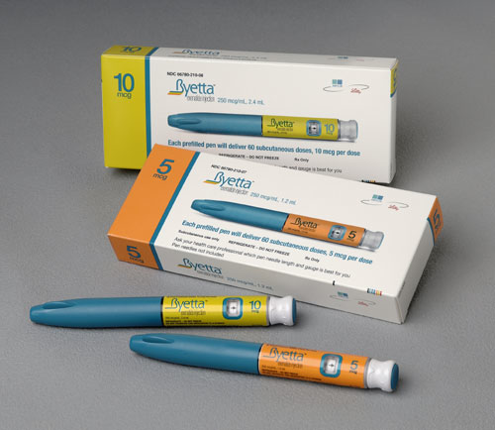
Analogues
Incretin Analogue Synthetic analog of GLP-1
(glucagon like peptide 1)
MOA: GI hormone (GLP-1) that acts on hypothalamus
→ secrete insulin
Pros:
1. Minimal hypoglycemia
Cons:
Never with Insulin
S/S pancreatitis: Severe nausea
Exenatide: avoid if CrCl < 30 mg/min
Generic | Brand | Dose
Exenatide | Byetta | Initial: 5 mcg SQ BID Maintenance: 10 mcg SQ BID
Liraglutide | Victoza | Initial: 0.6 mg SQ daily Maintenance: 1.2 mg SQ daily Max: 1.8 mg SQ daily

Slide 22
Drugs: overview
Liver/Periphery
Metformin
Thiazolidinediones(TZD)
Pancreas
Sulfonylurea
Meglitinide
GI tract
Alpha glucosidase inhibitor
Analogue
Amylin Analogue
Incretin Analogue
DPP-4 inhibitor
Usual Monitoring
Glycemic control
HgA1c every 3 months
Baseline renal function annually
LFT annually

Slide 23
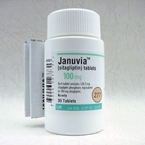
DDP-4
DDP-4 inhibitor
MOA: Inhibit DDP-IV → increase GLP-1
Efficacy
HgA1c: 0.5 – 0.8%
Active GLP-1
DDP-4
Inactive GLP-1
-gliptin
Generic | Brand | Dose
Sitagliptin | Januvia | If CrCl > 50: 100 mg daily If CrCl 30 - 50 50 mg daily If CrCl < 30 25 mg daily
Saxagliptin | Onglyza | If CrCl > 50 5 mg daily If CrCl < 50 2.5 mg daily
Linagliptin | Trajenta | 5 mg daily

Slide 24
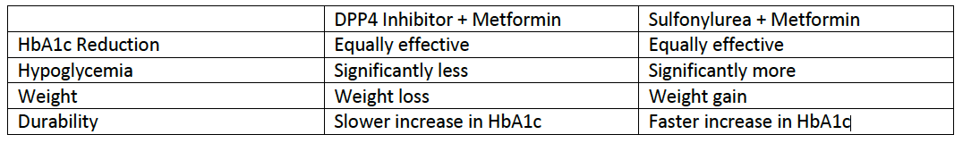
Combo | Brand
Metformin + Glyburide | Glucovance
Metformin + Glipizide | Metaglip
Metformin + Rosiglitazone (Avandia) | Avandamet
Metformin + Pioglitazone (Actos) | Actoplus Met
Metformin + Januvia | Janumet
Amaryl + Avandia | Avandaryl
Amaryl + Actos | Duetact

